Slide 1
STUDY ON DESIGN FOR RELIABILITY CONSIDERATION OF SoC FOR SPACE APPLICATION
Lakshmi Priya S
Reliability and Quality Assurance Hardware Group (RQHG)
09 Oct 2025 – 21 Nov 2025

Slide 2
INTRODUCTION
Satellites comprise multiple systems to accomplish mission objectives such as imaging, communication, navigation, and telemetry called as payload.
The Data Handling System(DHS) plays a pivotal role in acquiring, processing, storing, and routing digital data generated by various payload sensors and instruments.
The processed data is subsequently interfaced with the Radio Frequency (RF) subsystem for modulation, demodulation. Efficient operation of the DHS is therefore essential for maintaining the accuracy, reliability, and continuity of spacecraft mission data.
The reliability evaluation and derating analysis of critical components within the digital data handling path, with specific emphasis on Field Programmable Gate Arrays (FPGAs) and System-on-Chip (SoC)-based architectures are performed which are present in the Integrated Avionics Package(IAP) as shown in figure 1.

Slide 3
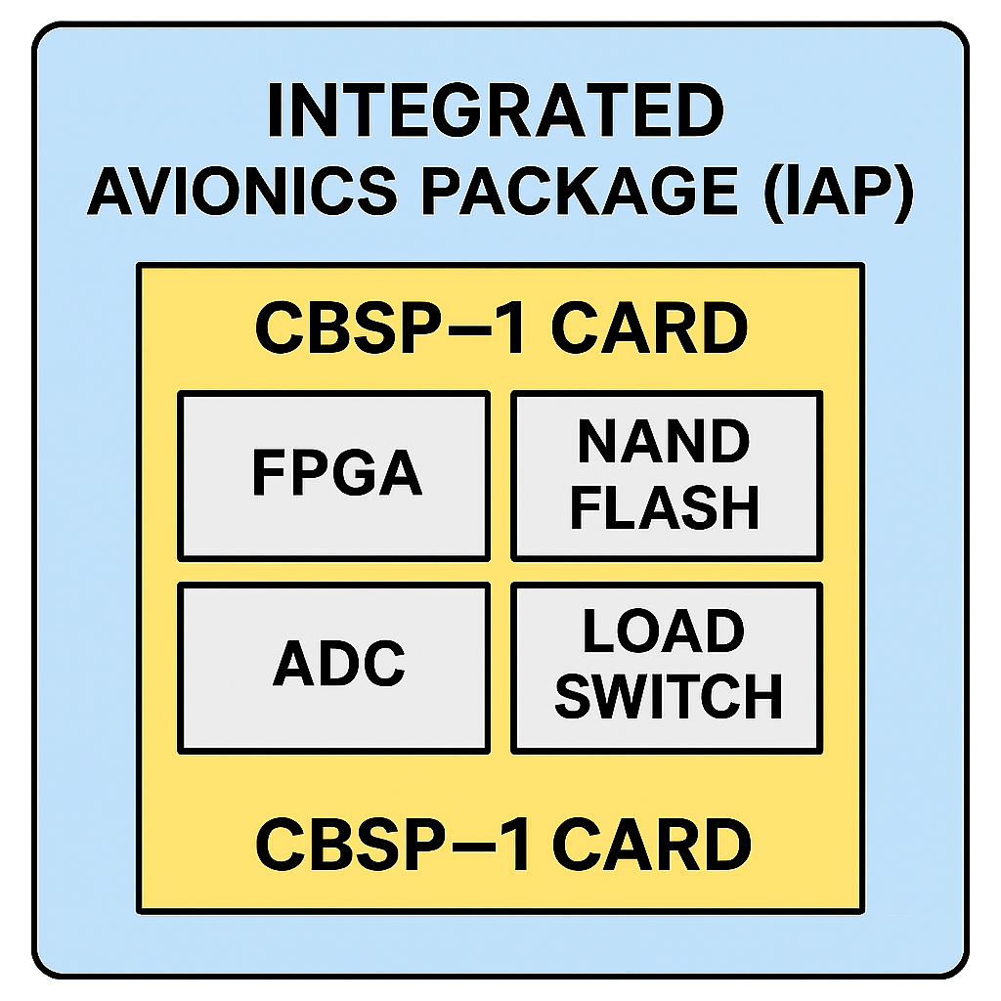
Figure 1: Components within IAP

Slide 4
Objective of the Work
To analyse the reliability-oriented design considerations for the integration of System-on-Chip (SoC) architectures in satellite data handling systems, ensuring that component selection and configuration meet mission reliability requirements.
To implement systematic derating analysis for selected Field Programmable Gate Arrays (FPGAs) and Integrated Circuits (ICs) by evaluating output current utilization.
To improve the overall SoC integration framework by developing layout and system-level design guidelines for digital and RF subsystems.

Slide 5
System Overview
A typical satellite payload system comprises three primary functional elements: the payload, the data handling subsystem, and the Radio Frequency (RF) subsystem as shown in figure 1.
Payload : responsible for data acquisition, capturing signals in either analog or digital form depending on the mission objectives and transmit in digital form.
Data Handling System : processes the acquired payload data through a sequence of operations such as data formatting, compression, storage, and packetization. The processed data is then transferred to the RF system.
Radio Frequency : which performs modulation, amplification, and downlink transmission to the ground station for further analysis.

Slide 6
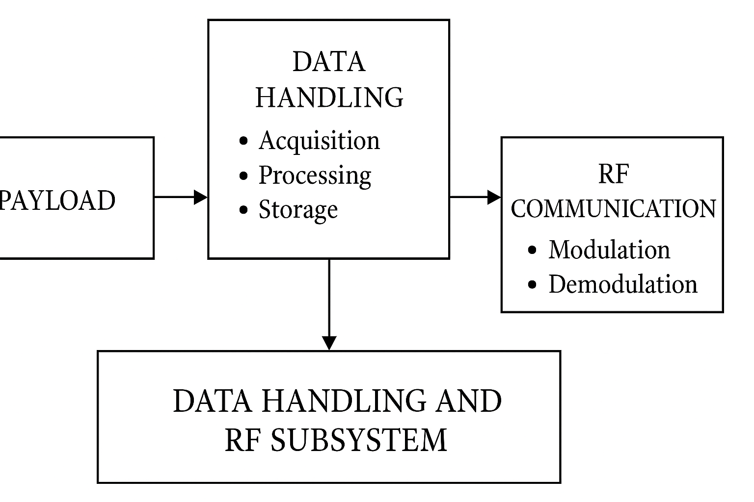
Payloads
Data Handling and RF System
Figure 1: Data Handling flow

Slide 7
System On Chip (SoC)
A System on Chip (SoC) integrates all major electronic components like processor, memory, input/output interfaces, and communication modules onto a single silicon substrate as shown in figure 2.
It combines digital, analog, and RF functions, providing compact, power-efficient, and high-performance designs essential for spacecraft avionics.
The integration allows faster data transfer between systems and better synchronization of onboard processes.
Their low power consumption supports extended mission lifetimes in energy-constrained environments.
Overall, SoCs represent the future of space electronics, combining intelligence, efficiency, and miniaturization in a single platform.

Slide 8
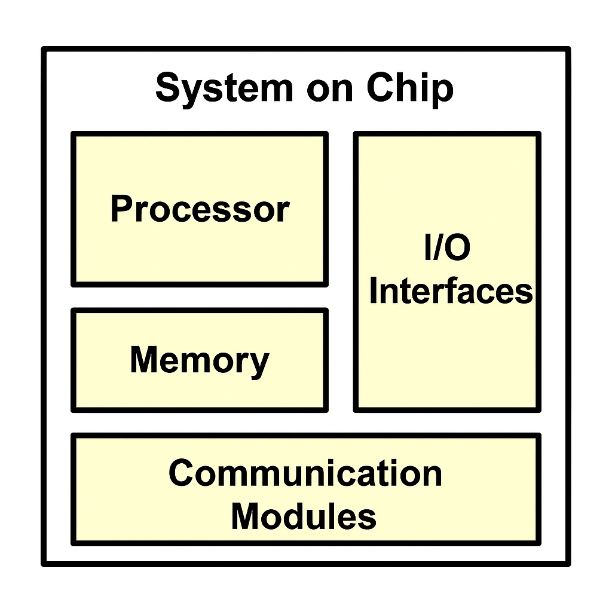
Figure 2: System on Chip

Slide 9
Advantages
Improves signal integrity and system reliability.
Reduces interconnection losses and enhance processing speed.
Simple design with fewer connections.
Cost-effective and scalable for multiple mission types.
Improved data transfer and integration between digital and RF modules.
Compact size, reduced weight , provide power efficient and high-performance design.

Slide 10
Guidelines for Digital and RF Integration
Minimize interference between digital and RF sections through isolation and shielding.
Use proper grounding and decoupling techniques.
Optimize PCB layout to reduce crosstalk and signal reflection.
Ensure stable clock distribution and synchronization.
Maintain thermal management using heat sinks or controlled dissipation paths.
Follow reliability prediction and testing for long-term space operation

Slide 11
Results
As a demonstration, a derating analysis has been performed on one of the functional modules within the Integrated Avionics Package (IAP). The IAP serves as a unified system that combines the capabilities of the On-board Computer, Data Handling Unit, Storage Module, Satellite Navigation Subsystem, and Telemetry, Tracking, and Command (TMTC) transceiver for signal modulation and demodulation.
Derating Parameters and Derating factors
Components | Parameters | Derated Factor
FPGA NAND FLASH LOAD SWITCH ADC TEMPERATURE SENSOR OSCILLATOR | Output current | 80%
 | Supply voltage | 90%
 | Junction temperature | 110˚C
 | Power dissipation | 80%
 | Input voltage | As per the Manufacturer recommendation

Slide 12
Conclusion
A clear understanding of reliability assessment and design methodologies essential for SoC-based satellite systems was developed through practical engagement with digital–RF integrated architectures.
Work involved integrating digital and RF subsystems within a single chip to enhance performance, reduce hardware footprint, and improve data handling efficiency. Derating analysis showed that reducing component stress significantly increases mission lifetime.
The study also established concise design and layout guidelines for mixed-signal SoC integration addressing substrate noise isolation, signal integrity, and thermal management forming a strong foundation for future space-grade digital-RF SoC developments.

Slide 13
References
[1] M. Wirthlin, “High-Reliability FPGA-Based Systems: Space, High-Energy Physics, and Beyond,” Proceedings of the IEEE, vol. 103, no. 3, pp. 379–389, Mar. 2015.
[2] Haoming Du, “Radio Frequency System-on-Chip Design for Digital Receiver,” IEEE Xplore, pp. 353-356, Nov. 2018. Francesco Restuccia
[3] Francesco Restuccia, “Cut and Forward: Safe and Secure Communication for System on Chip” IEEE Transaction, vol. 41, no.11, pp. 4052-4063, Nov. 2022
[4] F. Restuccia and A. Biondi, “Time-predictable acceleration of deep neural networks on FPGA SoC platforms,” in Proc. IEEE Real-Time Syst. Symp. (RTSS), 2021, pp. 441–454.
[5] NASA, “2020 Technology Taxonomy.” [Online]. Available: https://www.nasa.gov/sites/default/files/atoms/files/2020_nasa_technology_taxonomy.pdf

